Slide 1

BIOMETRIC BASED TRANSACTION SYSTEM
UMWALI DUSENGE Evelyne
ID : 26642

Slide 2


Introduction
In era where digital transactions are at the core of daily operations across financial, healthcare, educational, and government sectors, ensuring secure and reliable authorization methods has become critical. Traditional security approaches—such as PINs, passwords, and security tokens—are increasingly vulnerable to breaches, identity theft, and social engineering attacks. To address these challenges, the Biometric-Based Transaction Authorization System offers a modern, robust, and user-friendly solution.
This system is intended for use in environments where secure, fast, and reliable transaction authorization is critical. Target sectors include:
Banks and financial institutions for customer identity verification during high-value transactions.
Hospitals and healthcare systems for secure access to patient records and authorization of critical medical procedures.
Government offices for validating citizen identity in public service transactions.
Universities and educational institutions for secure student or staff transactions (e.g., exam registrations, access to digital resources).
PHASE I

Slide 3
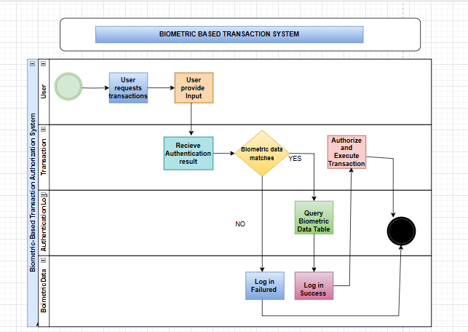
UML/BPMN
The diagram consists of four swimlanes representing key entities: User, Transaction System, Biometric Data Table, and Authentication Logs Table. The process begins when a User initiates a transaction, triggering the system to request biometric authentication. The Transaction System captures the user’s biometric input and queries the Biometric Data Table to verify it against stored biometric templates.
A decision gateway evaluates whether the input matches. If authentication is successful, the transaction is processed, and a success log is recorded in the Authentication Logs Table. If the match fails, the transaction is rejected, and a failure log is created. The process then ends by notifying the user of the outcome.
PHASE II

Slide 4

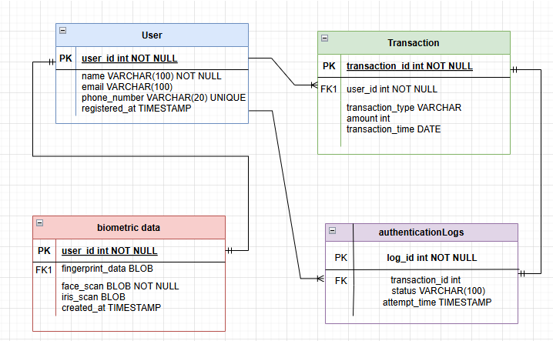
WHAT THIS PHASE COVERS
This phase focuses on designing a detailed and robust logical data model for the project. The goal is to create a structure that accurately represents entities, their attributes, and relationships while ensuring the design can handle real-world data scenarios.
ERD (ENTITY RELATIONSHIP DIAGRAM)
• Logical structure of database entities and relationships.
• Key Entities: User, Transaction, Boimetric data, AuthenticationLog.
• Demonstrates cardinality & foreign key constraints
PHASE III
RELATIONSHIPS:
User - AuthenticationLog (1:M)
User - Transaction (1:M)
User - Biometric Data (1:1)
Transaction - AuthenticationLog (1:1)

Slide 5
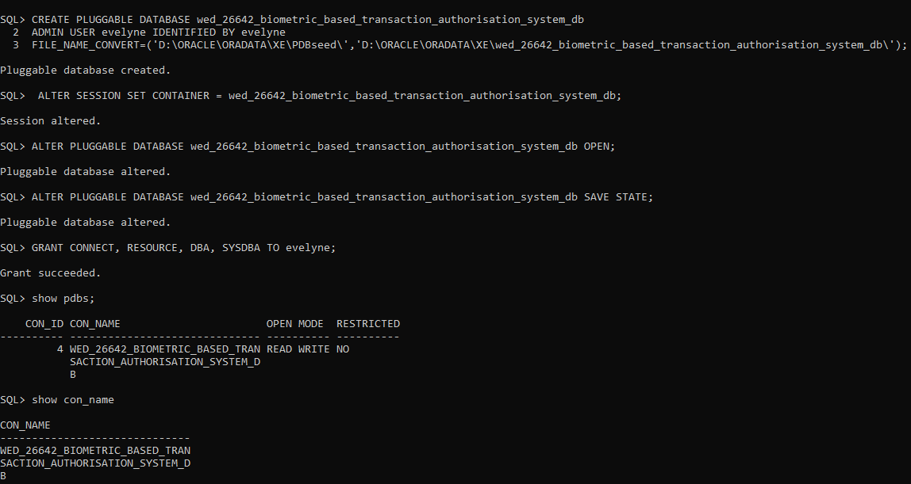
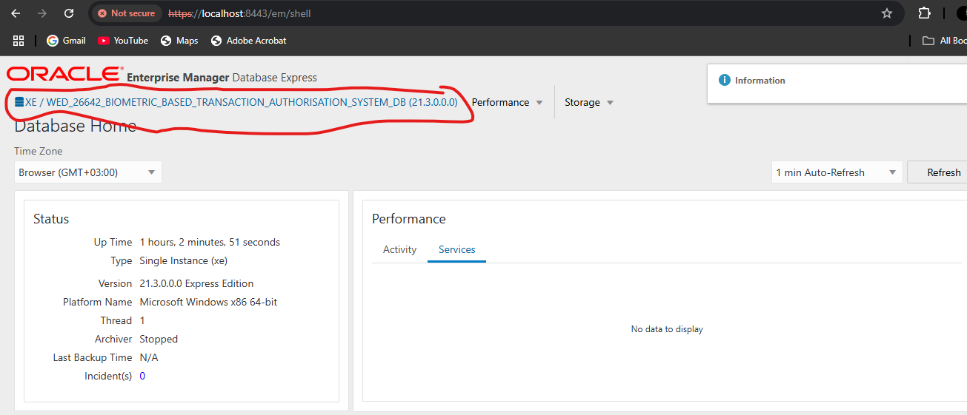

PHASE IV
Oracle Enterprise Manager (OEM)
Oracle Enterprise Manager (OEM) is not a PL/SQL keyword or feature—it’s Oracle’s web-based administrative console for the entire Oracle technology stack (databases, middleware, engineered systems, cloud services, etc.). When people mention OEM while discussing PL/SQL code, they’re usually talking about using the OEM interface to manage, monitor, or debug that code inside the database.
This Phase Covers
This phase focuses on creating a Pluggable Database (PDB) and converting the logical model into a physical database structure. It ensures that all tables, relationships, and constraints are implemented to meet project requirements.

Slide 6
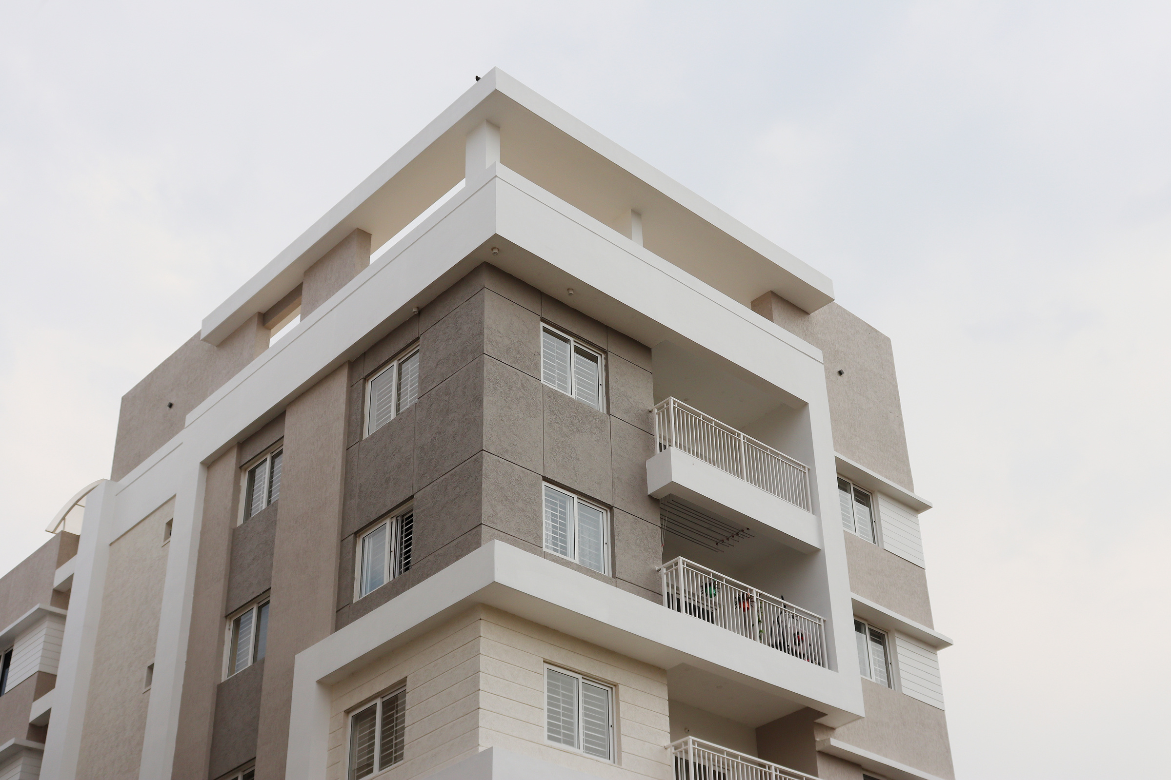
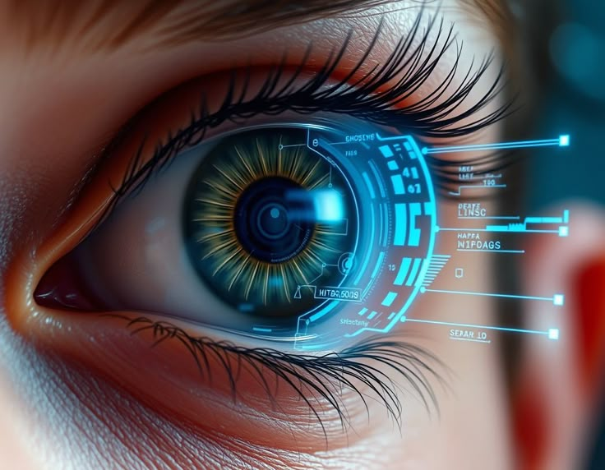

Physical Database Structure
Physical Database Structure converts the logical. Entity-Relationship model into a physical Oracle database structure, implementing all required tables, relationships, and data integrity constraints to support biometric-based authentication for secure financial transactions
Example of creating a table called users
CREATE TABLE users (
user_id NUMBER PRIMARY KEY,
username VARCHAR2(50) UNIQUE,
email VARCHAR2(100),
created_at DATE DEFAULT SYSDATE
);
PHASE V
Example of inserting data
INSERT INTO users (user_id, username, email, created_at)
VALUES (1, 'Niece', 'niece@gmail.com', TO_DATE('2024-05-19','YYYY-MM-DD'));

Slide 7

This phase covers:
Implementation of logic for modular database operations using DML & DDL, Procedure, functions, packages, expception handling and analytical queries, all aligned with the Biometric Based Transaction System database.
USING PL\SQL PACKAGES & PROCEDURES
Organized database operation for making transactions.
Parametirised procedurse for flexible data retrieval
Cursors for efficient data handling
Exception handling to manage errors
Sample of a created procedure
CREATE OR REPLACE PACKAGE BODY biometric_pkg IS
PROCEDURE fetch_transactions_by_user(p_user_id NUMBER) IS
v_amount transactions.amount%TYPE;
BEGIN
FOR rec IN (SELECT transaction_id, amount, transaction_time
FROM transactions
WHERE user_id = p_user_id) LOOP
DBMS_OUTPUT.PUT_LINE('Transaction ID: ' || rec.transaction_id ||
', Amount: ' || rec.amount ||
', Time: ' || rec.transaction_time);
END LOOP;
END;
END biometric_pkg;
PHASE VI

Slide 8


🔹Problem Statement
In the Biometric-Based Transaction Authorization System, it is critical to ensure that all data manipulations—especially those involving sensitive user and transaction records—are tightly controlled, secure, and auditable. This is to prevent unauthorized changes that could compromise data integrity or breach security regulations.
PHASE VII
USE OF TRIGGERS AND AUDITING FOR SECURITY
Sample of a created a trigger
CREATE OR REPLACE TRIGGER trg_block_weekday_and_holiday_dml
BEFORE INSERT OR UPDATE OR DELETE ON transactions
FOR EACH ROW
DECLARE
v_day VARCHAR2(10);
v_today DATE := TRUNC(SYSDATE);
v_next_month_start DATE := TRUNC(ADD_MONTHS(SYSDATE, 1), 'MM');
v_next_month_end DATE := LAST_DAY(v_next_month_start);
v_count INTEGER;
BEGIN
-- Check for weekday (Mon–Fri)
SELECT TO_CHAR(v_today, 'DY', 'NLS_DATE_LANGUAGE=ENGLISH') INTO v_day FROM dual;
IF v_day IN ('MON', 'TUE', 'WED', 'THU', 'FRI') THEN
RAISE_APPLICATION_ERROR(-20001, 'DML operations are not allowed on weekdays.');
END IF;
-- Check for holidays in next month
SELECT COUNT(*) INTO v_count
FROM holidays
WHERE holiday_date = v_today
AND holiday_date BETWEEN v_next_month_start AND v_next_month_end;
IF v_count > 0 THEN
RAISE_APPLICATION_ERROR(-20002, 'DML operations are not allowed on public holidays.');
END IF;
END;
Triggers are required to enforce time-based and holiday-based restrictions on table manipulations.
Auditing enables real-time tracking of sensitive operations to strengthen security and support compliance.

Slide 9



CONCLUSION
The Biometric-Based Transaction Authorization System database schema provides a robust security framework that replaces vulnerable traditional authentication methods with advanced biometric verification, effectively addressing fraud risks across multiple sectors while delivering a seamless user experience without credential management burdens; the carefully structured relational model—with encrypted biometric storage, comprehensive transaction tracking, and thorough audit trails—ensures regulatory compliance, optimal performance, and enterprise-level scalability.
REFERENCE:
1.Oracle Corporation. (2024). Oracle Database 21c PL/SQL Language Reference
2. National Institute of Standards and Technology (NIST). (2022)(https://pages.nist.gov/800-63-3/).

Slide 10

THANK YOU

